Slide 1
Driver Pass
System and Design

Slide 2
System Requirements
Add your first bullet point here
Add your second bullet point here
Add your third bullet point here

Slide 3
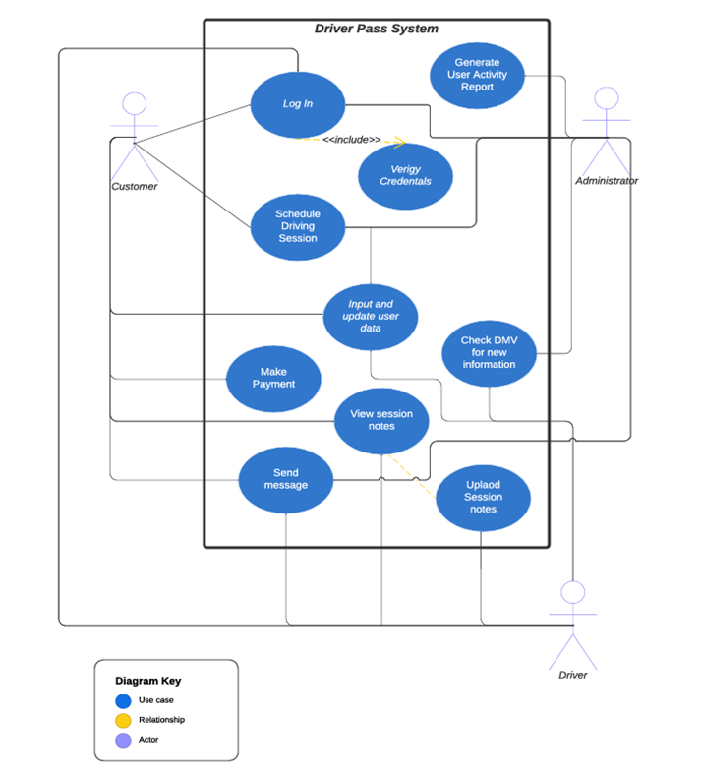
Use Case Diagram

Slide 4
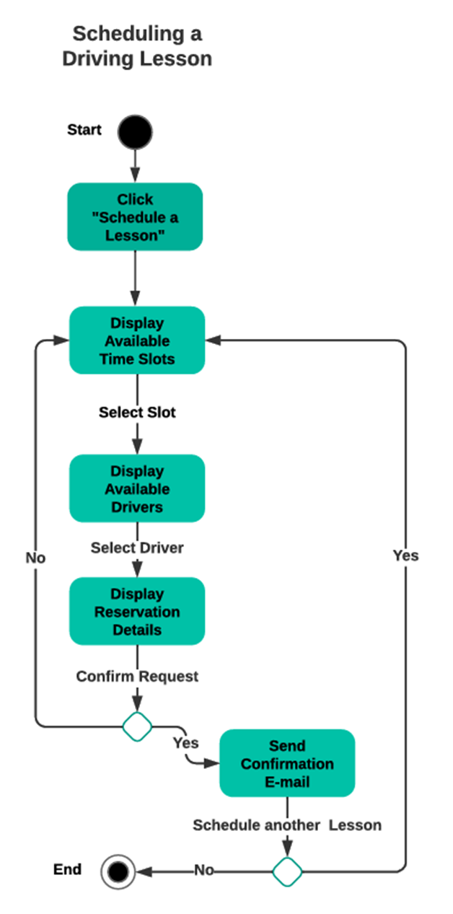
Activity Diagram

Slide 5
Security
AWS security measures will be used to protect personally identifiable information and financial information.
Encryption will be use in sending information as well as storing on databases.
Logs will be kept of user interactions with the system so that bad actors can be found and stopped.

Slide 6
System Limitations
Our system will be limited in its ability to provide information when the user is not online.
Our system will not be able to easily change the packages provided to the customers.
Our system will be limited in its ability to schedule multiple sessions at once.
Resources are limited as we are using AWS and the services they provide for the infrastructure.
Time is limited to the four and a half months before the project delivery deadline.
Budget is always a limit and will constrain the people we can pay to work on this project as well as the infrastructure we can implement to run the application.

